Slide 1
Work and Energy
Work, energy and power
Kinetic and potential energy
Law of conservation of energy

Slide 2
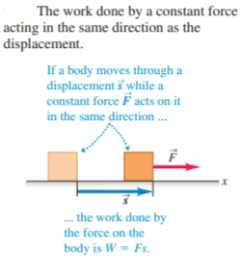
1. Work, energy and power
The physicist’s definition of work is based on these observations. Consider a body that undergoes a displacement of magnitude s along a straight line. (For now, we’ll assume that any body we discuss can be treated as a particle so that we can ignore any rotation or changes in shape of the body.) While the body moves, a constant force acts on it in the same direction as the displacement (Fig.). We define the work W done by this constant force under these circumstances as the product of the force magnitude F and the displacement magnitude s:

Slide 3
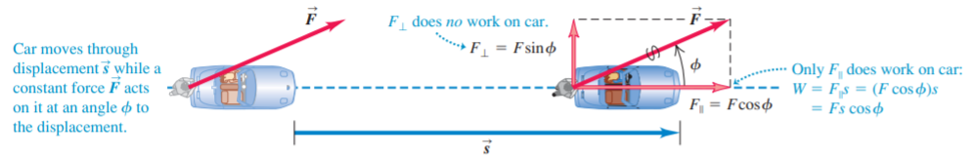


Slide 4
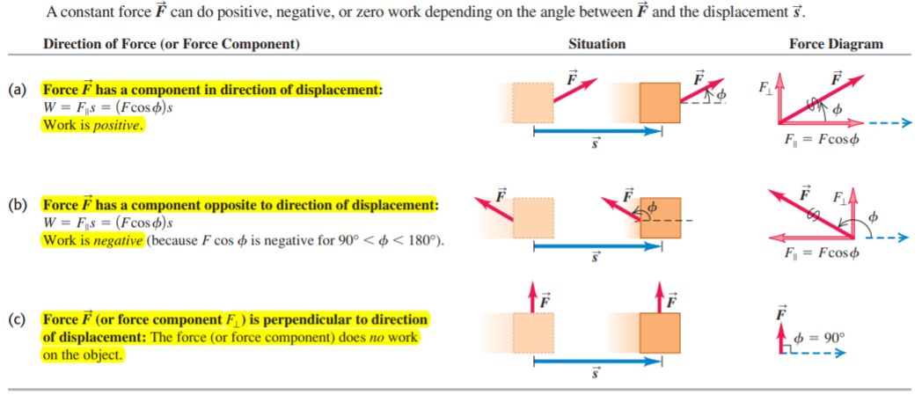

Slide 5
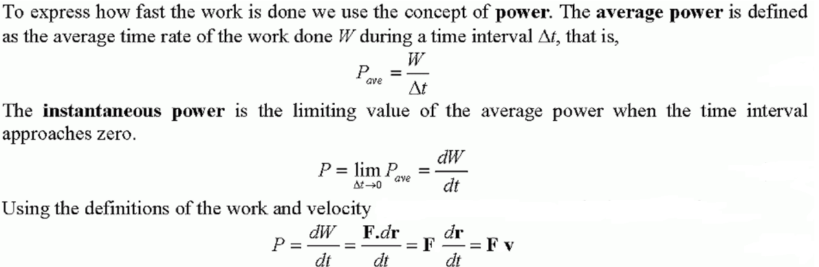
Power

Slide 6
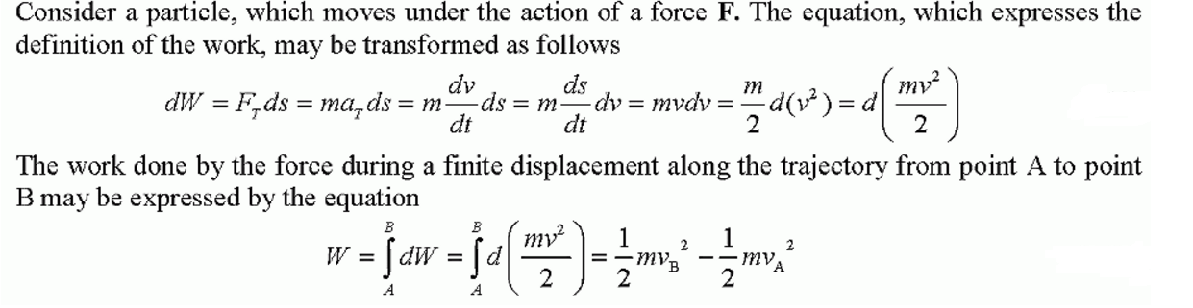
2. Kinetic and potential energy
2.1 Kinetic energy

Slide 7
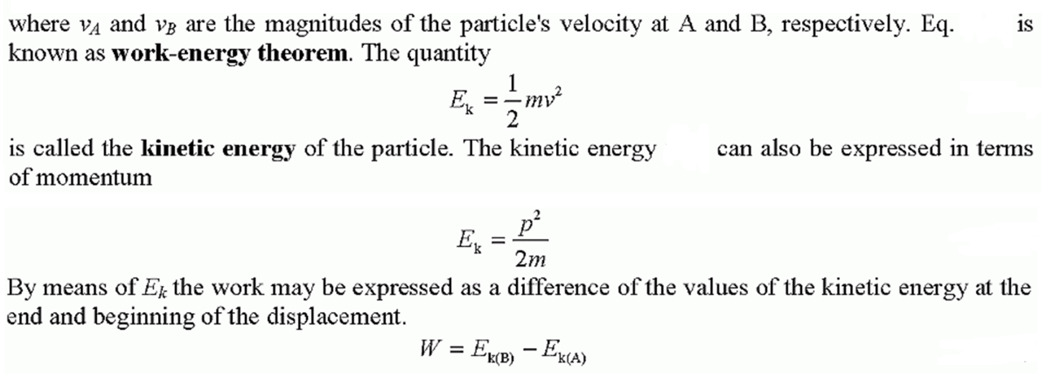
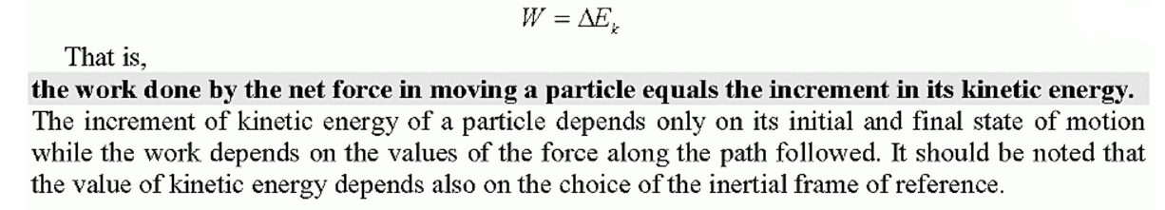

Slide 8
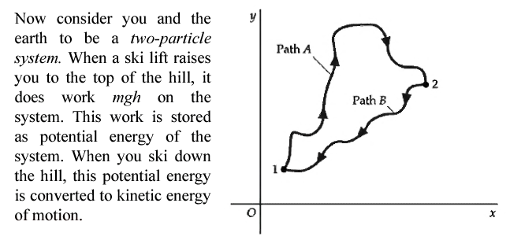
Potential energy

Slide 9
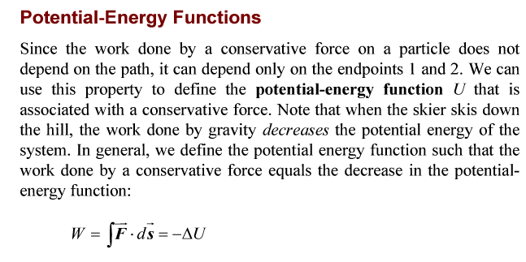
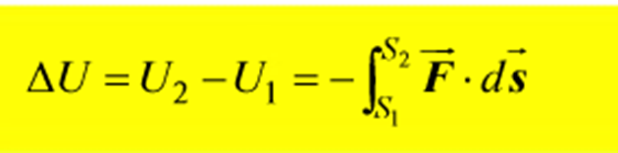

Slide 10
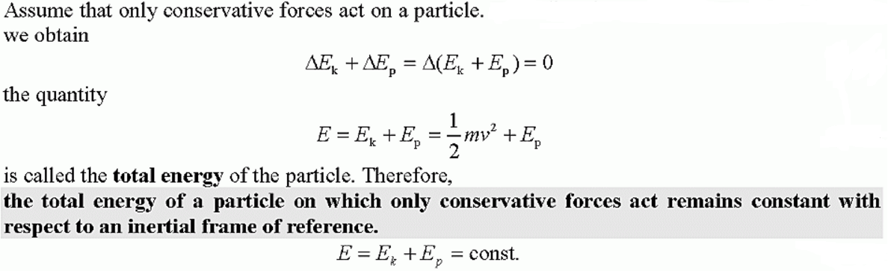
3. Law of conservation of energy

Slide 11

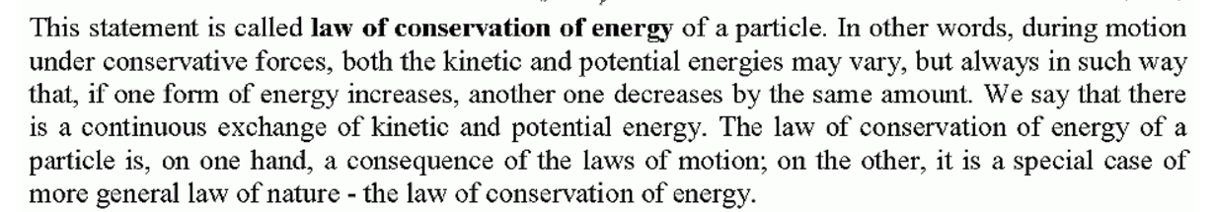

Slide 12
Thank you for attention!

