Slide 1
Dynamics of a material point
Newton’s First Law
Force, Mass and Newton’s Second Law
Newton’s Third Law
The Force due to Gravity: Weight

Slide 2
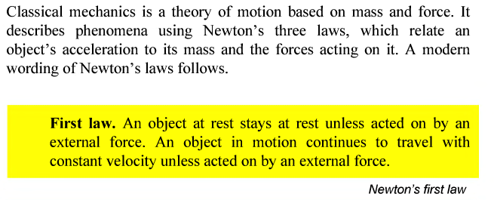
1. Newton’s First Law

Slide 3
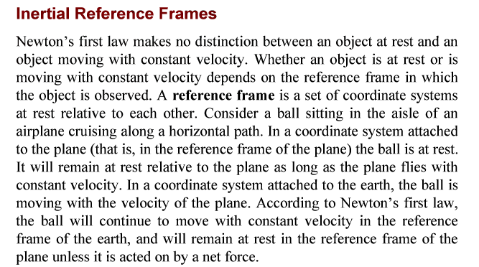

Slide 4
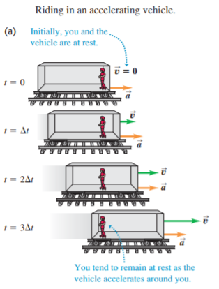
The point is that the bus is accelerating with respect to the earth and is not a suitable frame of reference for Newton’s first law. This law is valid in some frames of reference and not valid in others. A frame of reference in which Newton’s first law is valid is called an inertial frame of reference. The earth is at least approximately an inertial frame of reference, but the bus is not. (The earth is not a completely inertial frame, owing to the acceleration associated with its rotation and its motion around the sun.

Slide 5
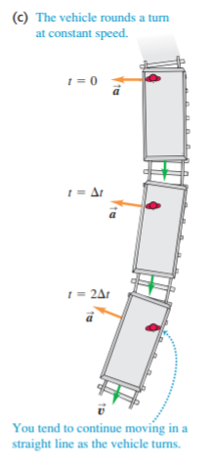
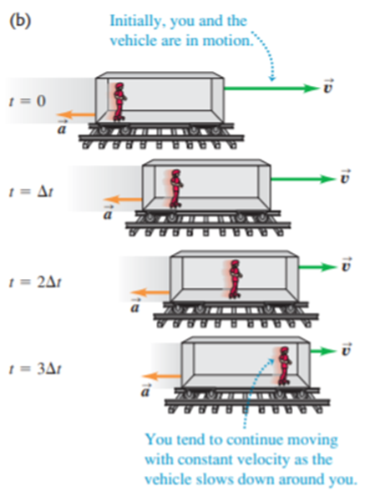

Slide 6
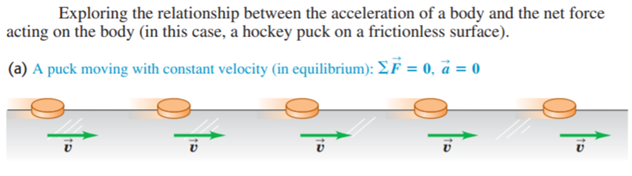
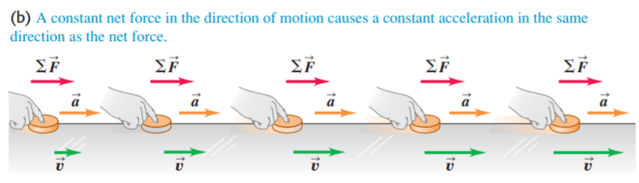
2. Force, Mass and Newton’s Second Law

Slide 7
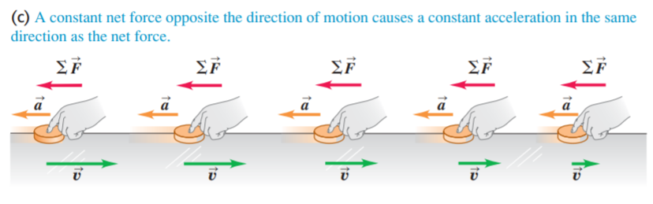

Slide 8
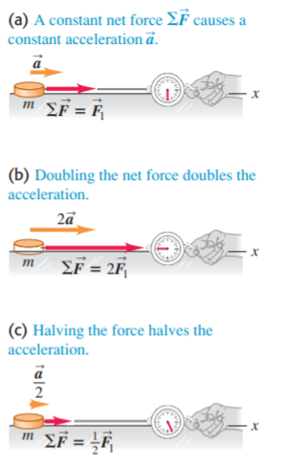
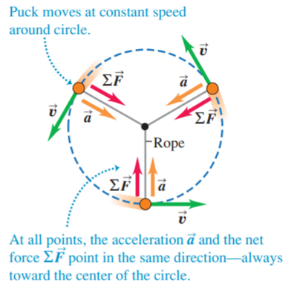

Slide 9
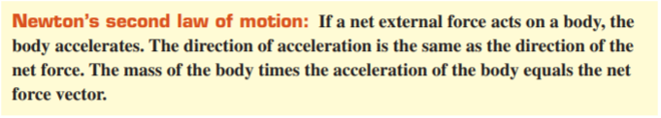
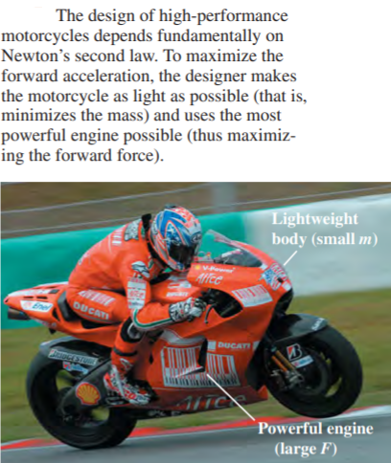

Slide 10
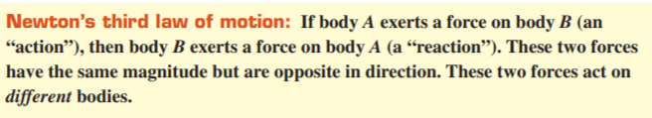
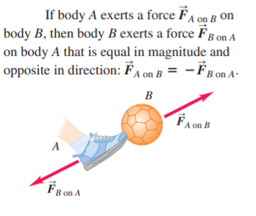
3. Newton’s Third Law

Slide 11
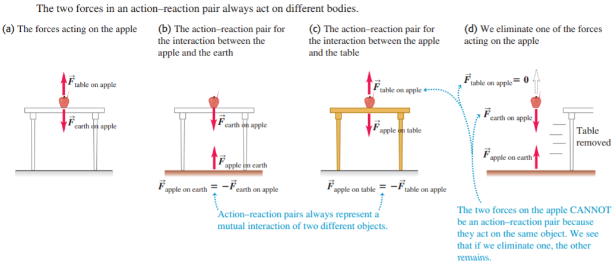

Slide 12
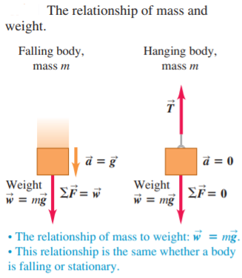
4. The Force due to Gravity: Weight
One of the most familiar forces is the weight of a body, which is the gravitational force that the earth exerts on the body. (If you are on another planet, your weight is the gravitational force that planet exerts on you.) Unfortunately, the terms mass and weight are often misused and interchanged in everyday conversation. It is absolutely essential for you to understand clearly the distinctions between these two physical quantities.

Slide 13
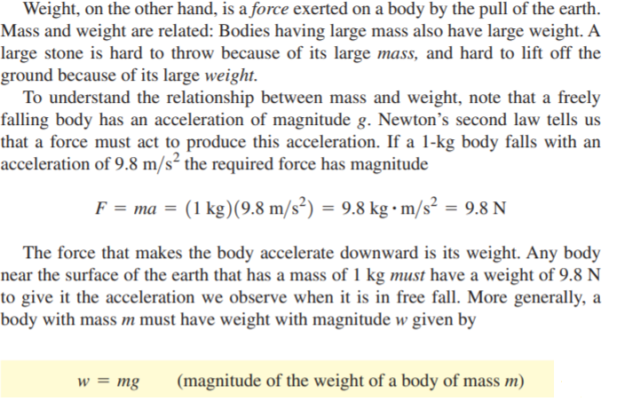

Slide 14
Thank you for attention!

