Slide 1
Heat and the First Law of Thermodynamics
Heat Capacity and Specific Heat
Change of Phase and Latent Heat
3. The First Law of Thermodynamics
The Internal Energy of an Ideal Gas
Work and the PV Diagram for a Gas
Heat Capacities of Gases
The Quasi-static Adiabatic Expansion of a Gas

Slide 2
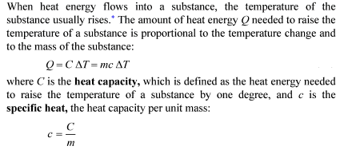
1. Heat Capacity and Specific Heat

Slide 3



Slide 4
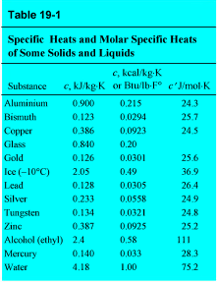
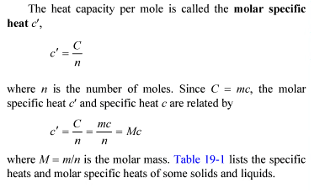

Slide 5
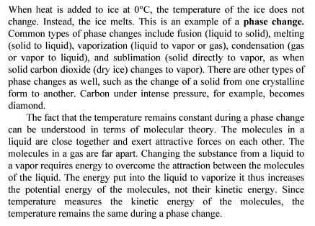
2. Change of Phase and Latent Heat

Slide 6
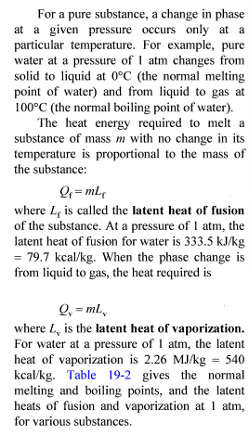
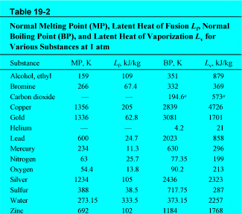

Slide 7
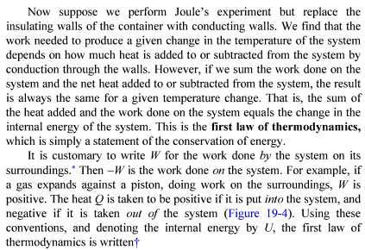
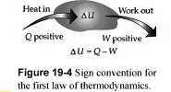

3. The First Law of Thermodynamics

Slide 8
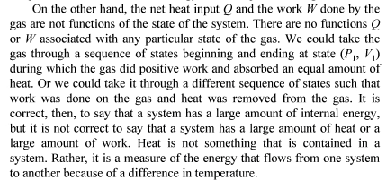


Slide 9

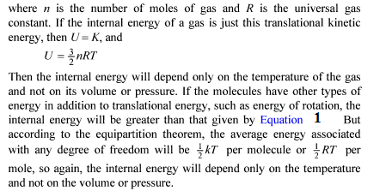
4. The Internal Energy of an Ideal Gas

Slide 10
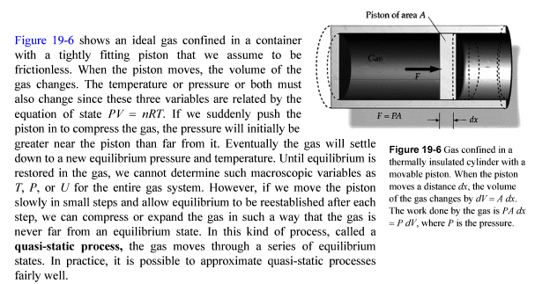
5. Work and the PV Diagram for a Gas

Slide 11
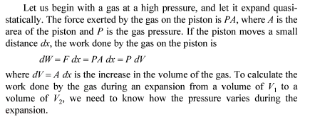

Slide 12
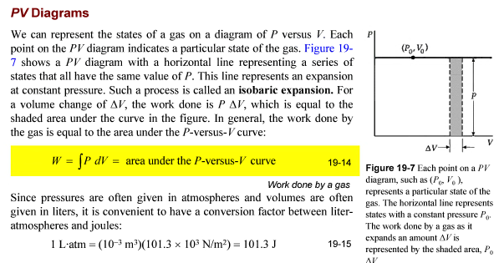

Slide 13

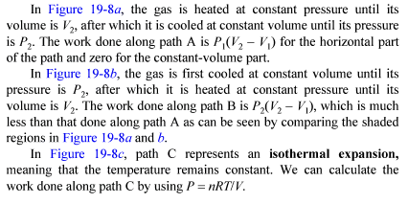

Slide 14
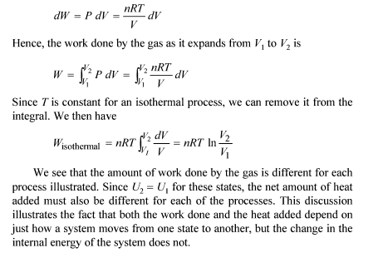

Slide 15
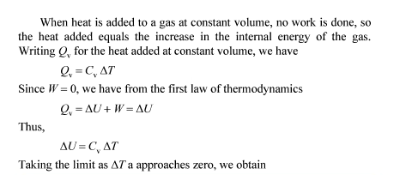

6. Heat Capacities of Gases

Slide 16
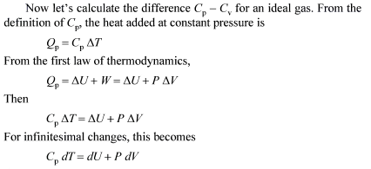


Slide 17
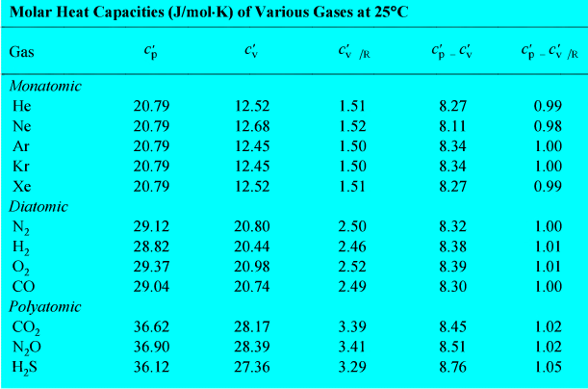

Slide 18

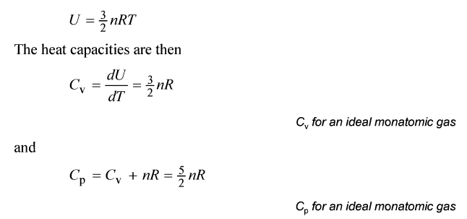

Slide 19
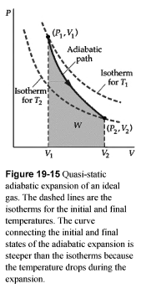
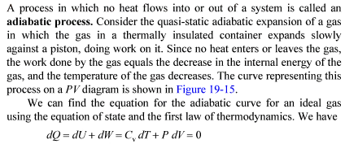
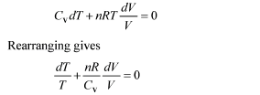
7. The Quasi-static Adiabatic Expansion of a Gas

Slide 20

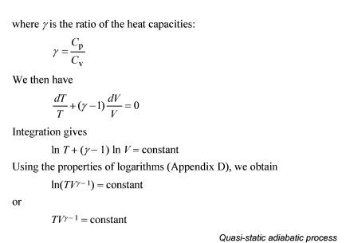

Slide 21

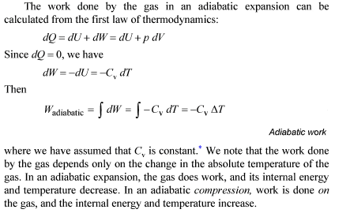

Slide 22
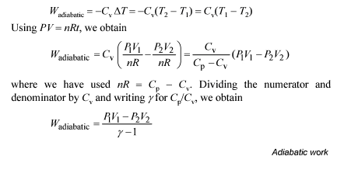

Slide 23
Thank you for attention!

