Slide 1
Kinematics of a material point
Displacement, Velocity and Speed
Acceleration
Motion with constant Acceleration

Slide 2
1. Displacement, Velocity and Speed
We are beginning our study of physics with mechanics, the study of the relationships among force, matter, and motion. In this chapter and the next we will study kinematics, the part of mechanics that enables us to describe motion. Later we will study dynamics, which relates motion to its causes.
How to describe straight-line motion in terms of average velocity, instantaneous velocity, average acceleration, and instantaneous acceleration.
How to interpret graphs of position versus time, velocity versus time, and acceleration versus time for straight-line motion.

Slide 3
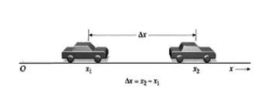

Let’s generalize the concept of average velocity. At time the dragster is at point with coordinate and at time it is at point with coordinate The displacement of the dragster during the time interval from to is the vector from to The x-component of the displacement, denoted is the change in the coordinate x:

Slide 4
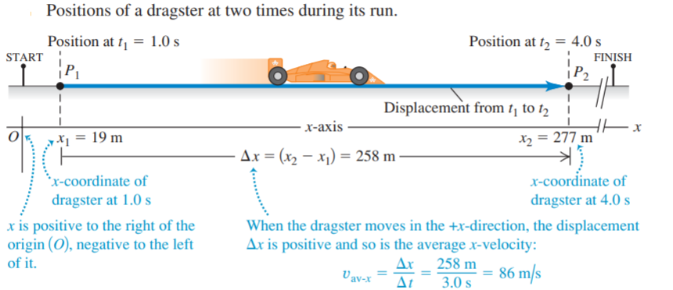

Slide 5
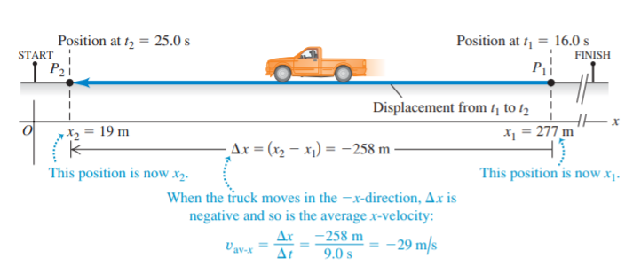

Slide 6
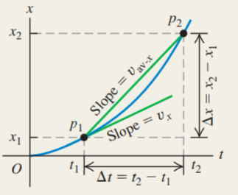

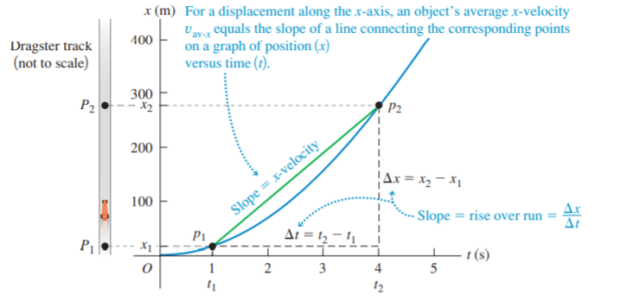

But the average velocity of a particle during a time interval can’t tell us how fast, or in what direction, the particle was moving at any given time during the interval. To do this we need to know the instantaneous velocity, or the velocity at a specific instant of time or specific point along the path.

Slide 7
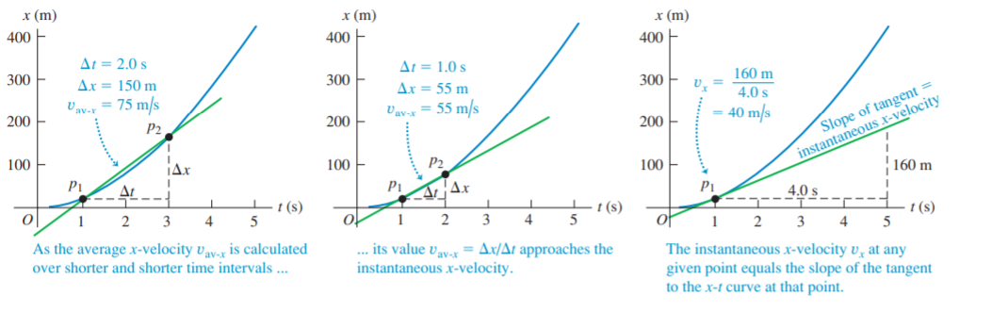

Slide 8
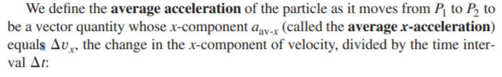
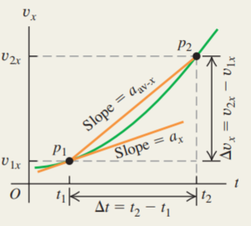

2. Acceleration

Slide 9
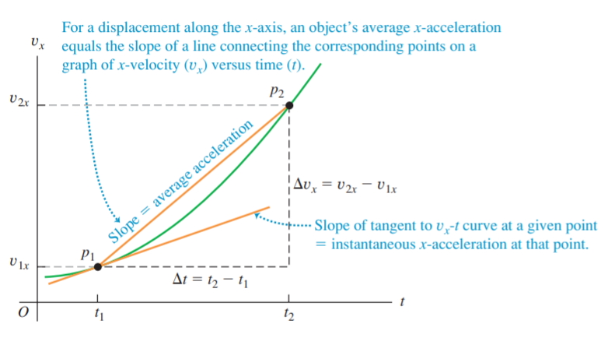
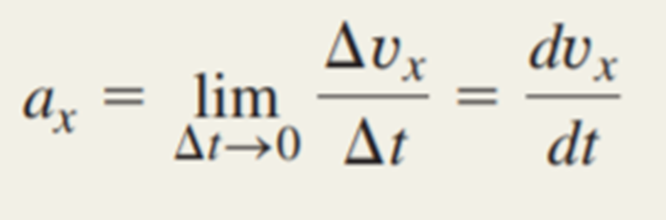

Slide 10
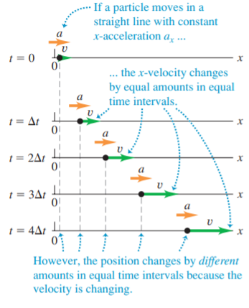
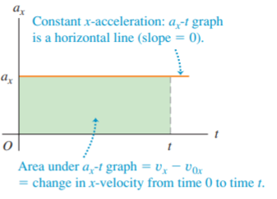
3. Motion with constant Acceleration

Slide 11
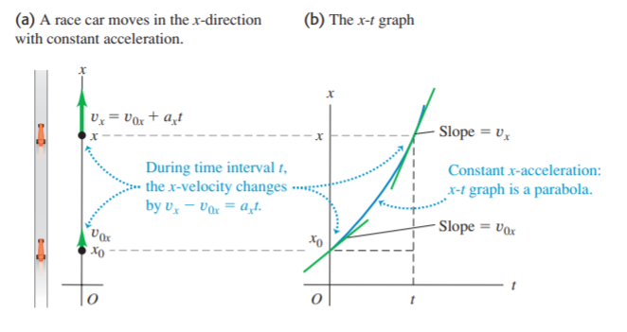

Slide 12
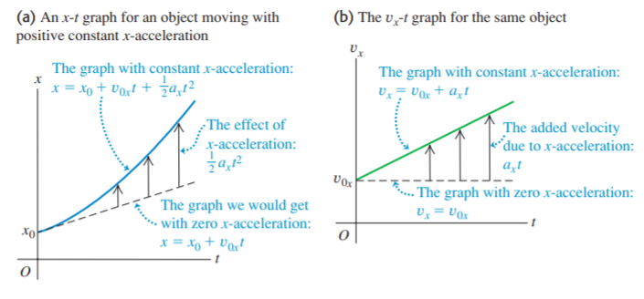

Slide 13
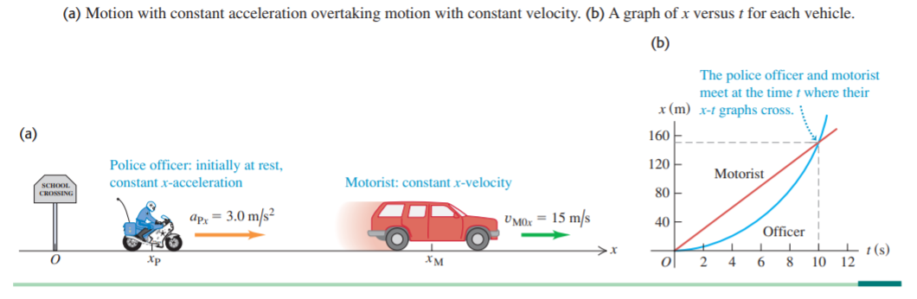

Slide 14
Thank you for attention!

