Slide 1
Moment of inertia of a solid
Moment of inertia
Proof of the Parallel-Axic Theorem
3. Rotational kinetic energy

Slide 2
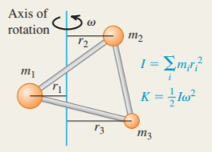
Moment of inertia
If a rigid body is a continuous distribution of mass—like a solid cylinder or a solid sphere—it cannot be represented by a few point masses. In this case the sum of masses and distances that defines the moment of inertia
Moment of inertia and rotational kinetic energy: The moment of inertia I of a body about a given axis is a measure of its rotational inertia: The greater the value of I, the more difficult it is to change the state of the body’s rotation. The moment of inertia can be expressed as a sum over the particles that make up the body, each of which is at its own perpendicular distance from the axis. The rotational kinetic energy of a rigid body rotating about a fixed axis depends on the angular speed and the moment of inertia I for that rotation axis.

Slide 3
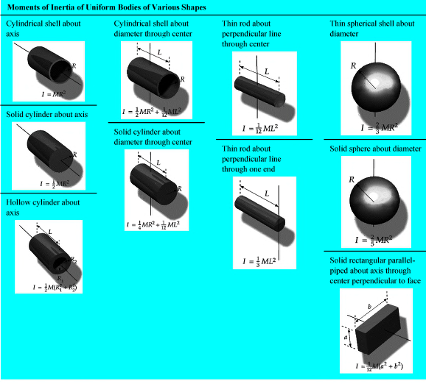

Slide 4
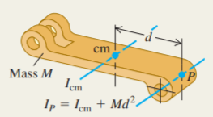

2. Proof of the Parallel-Axic Theorem
Calculating the moment of inertia: The parallel-axis theorem relates the moments of inertia of a rigid body of mass M about two parallel axes: an axis through the center of mass (moment of inertia ) and a parallel axis a distance d from the first axis. If the body has a continuous mass distribution, the moment of inertia can be calculated by integration.

Slide 5
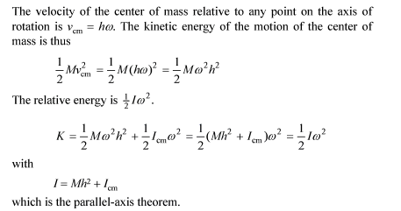

Slide 6
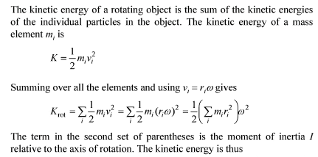


3. Rotational kinetic energy

Slide 7
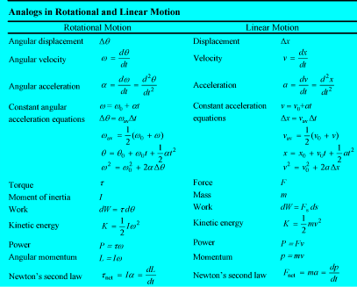

Slide 8
Thank you for attention!

