Slide 1
Temperature and the Kinetic Theory of Gases
Thermal Equilibrium and Temperature
The Ideal-Gas Law
The Kinetic Theory of Gases
Mean Free Path
The Distribution of Molecular Speeds

Slide 2
1. Thermal Equilibrium and Temperature
To measure the temperature of a body, you place the thermometer in contact with the body. If you want to know the temperature of a cup of hot coffee, you stick the thermometer in the coffee; as the two interact, the thermometer becomes hotter and the coffee cools off a little. After the thermometer settles down to a steady value, you read the temperature. The system has reached an equilibrium condition, in which the interaction between the thermometer and the coffee causes no further change in the system. We call this a state of thermal equilibrium.
The concept of temperature is rooted in qualitative ideas of “hot” and “cold” based on our sense of touch. A body that feels hot usually has a higher temperature than a similar body that feels cold. That’s pretty vague, and the senses can be deceived. But many properties of matter that we can measure depend on temperature. The length of a metal rod, steam pressure in a boiler, the ability of a wire to conduct an electric current, and the color of a very hot glowing object—all these depend on temperature. Temperature is also related to the kinetic energies of the molecules of a material. In general this relationship is fairly complex, so it’s not a good place to start in defining temperature.

Slide 3
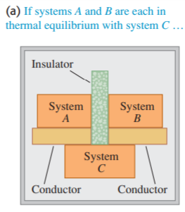
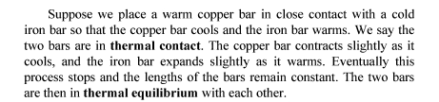

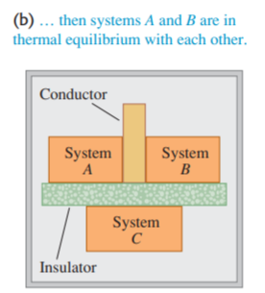

Slide 4
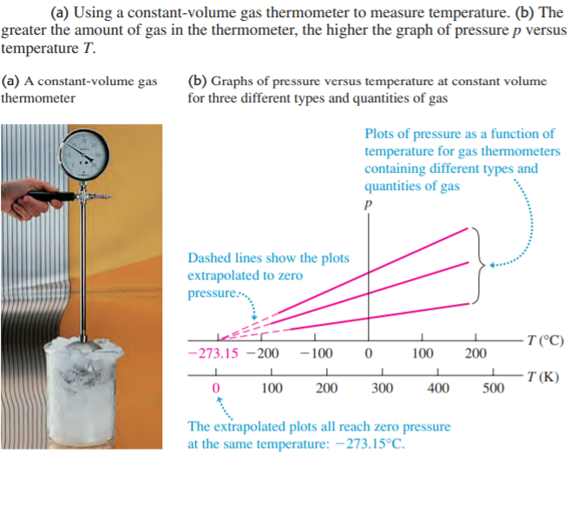

Slide 5
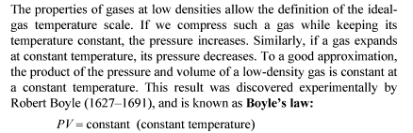
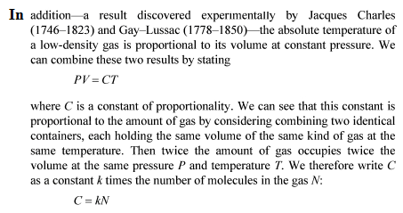
2. The Ideal-Gas Law

Slide 6

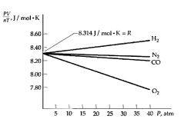
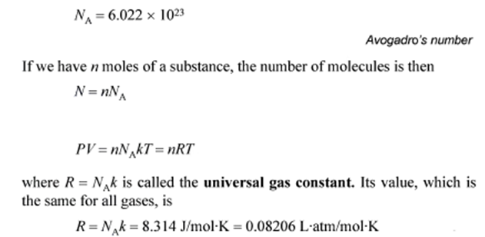
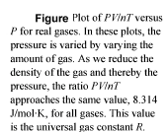

Slide 7
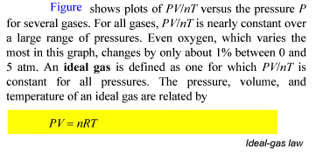

Slide 8


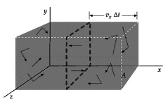

3. The Kinetic Theory of Gases

Slide 9
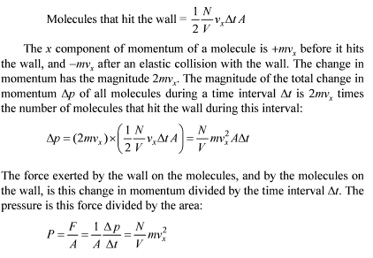

Slide 10

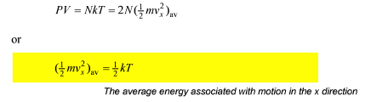

Slide 11
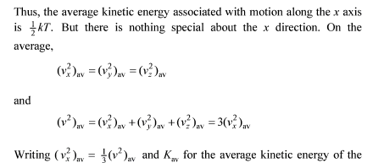
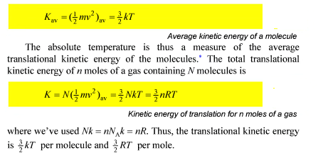

Slide 12
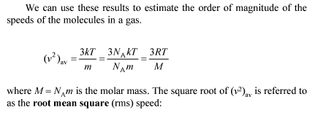

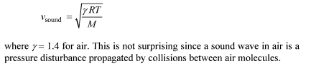

Slide 13
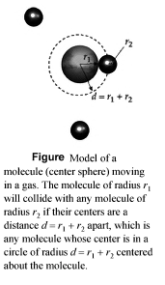
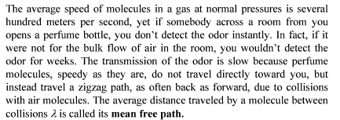

  4. Mean Free Path

Slide 14
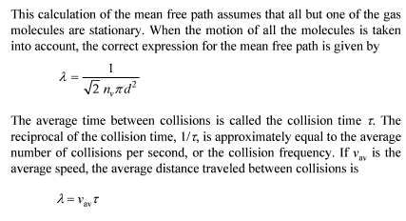
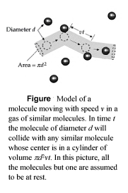

Slide 15
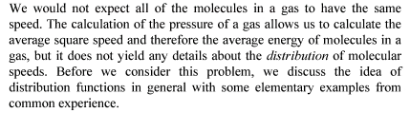
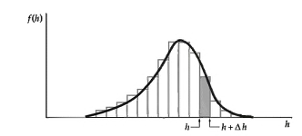
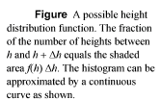
5. The Distribution of Molecular Speeds

Slide 16
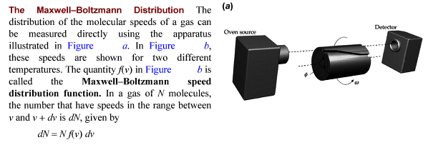

Slide 17
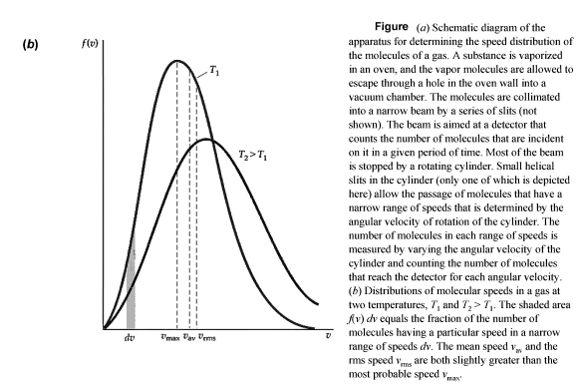

Slide 18
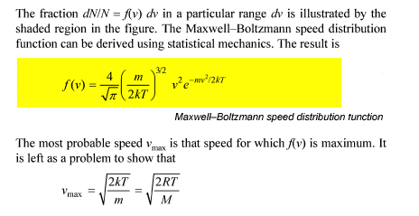

Slide 19
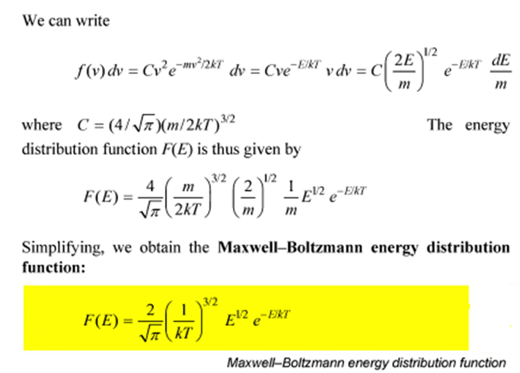

Slide 20
Thank you for attention!

