Slide 1
The Magnetic Field
The Force Exerted by a Magnetic Field
Motion of a Point Charge in a Magnetic Field
Torgues on Current Loops and Magnets
The Hall Effect

Slide 2
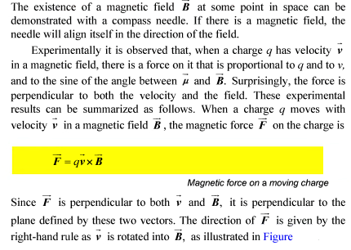
The Force Exerted by a Magnetic Field

Slide 3
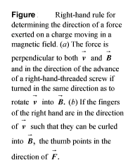
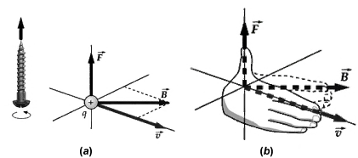

Slide 4

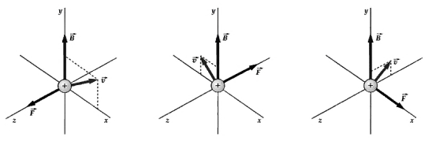


Slide 5
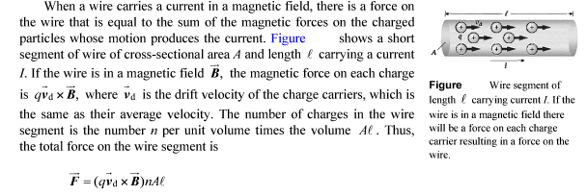

Slide 6
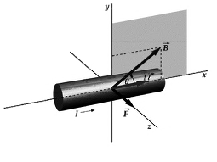
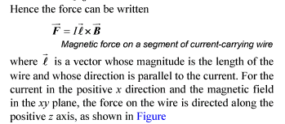
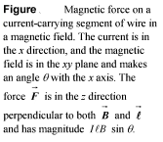

Slide 7
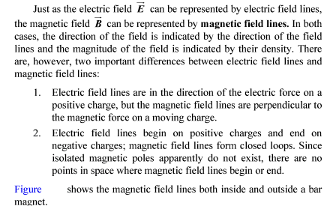

Slide 8
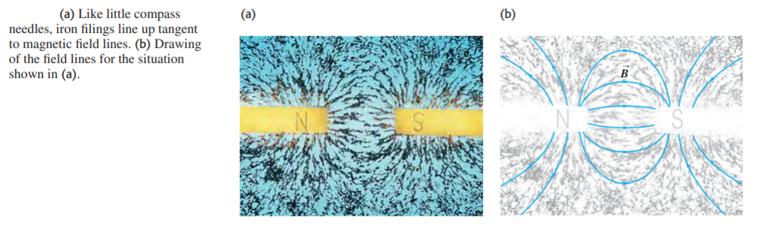

Slide 9
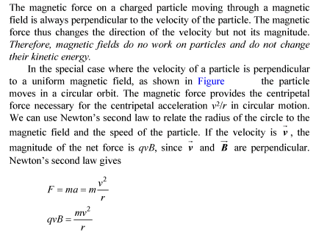
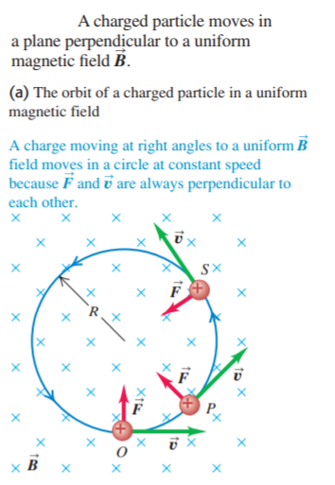
2. Motion of a Point Charge in a Magnetic Field

Slide 10
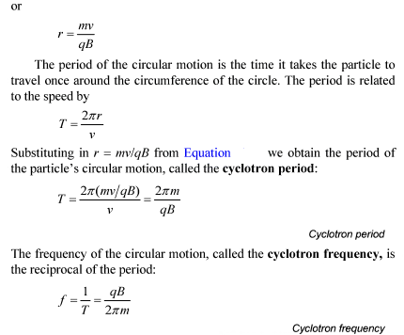

Slide 11
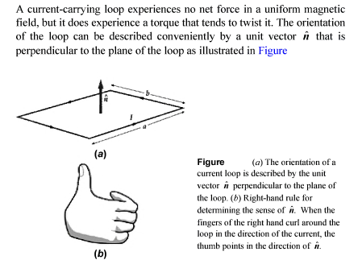
3. Torgues on Current Loops and Magnets

Slide 12
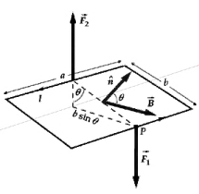
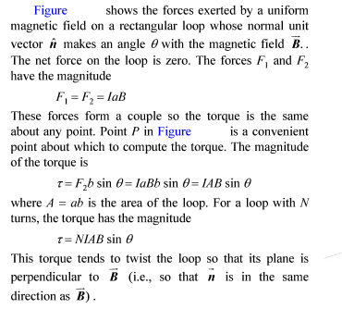
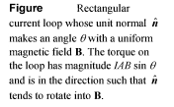

Slide 13
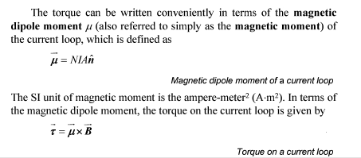

Slide 14
4. The Hall Effect
The reality of the forces acting on the moving charges in a conductor in a magnetic field is strikingly demonstrated by the Hall effect, an effect analogous to the transverse deflection of an electron beam in a magnetic field in vacuum. (The effect was discovered by the American physicist Edwin Hall in 1879 while he was still a graduate student.) To describe this effect, let’s consider a conductor in the form of a flat strip, as shown in Figure.

Slide 15
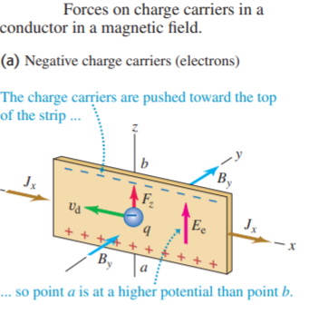
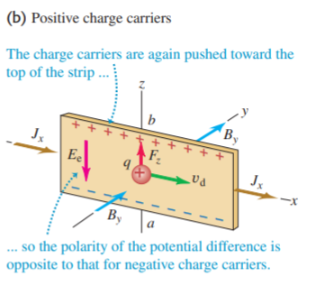

Slide 16
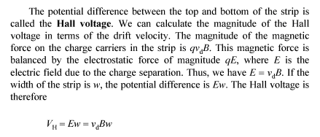

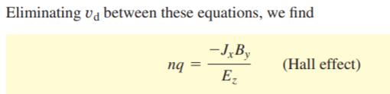

Slide 17
Thank you for attention!

